Slide 1
Riley Oaks HOA
Community and Homeowner
Property Accountability Clarification

Slide 2
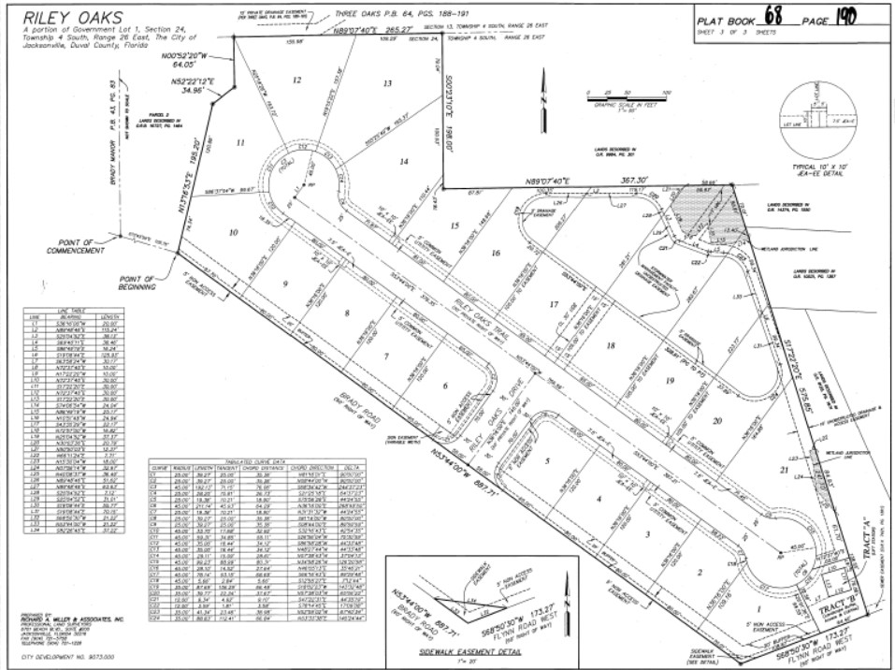
Riley Oaks Platt Map

Slide 3
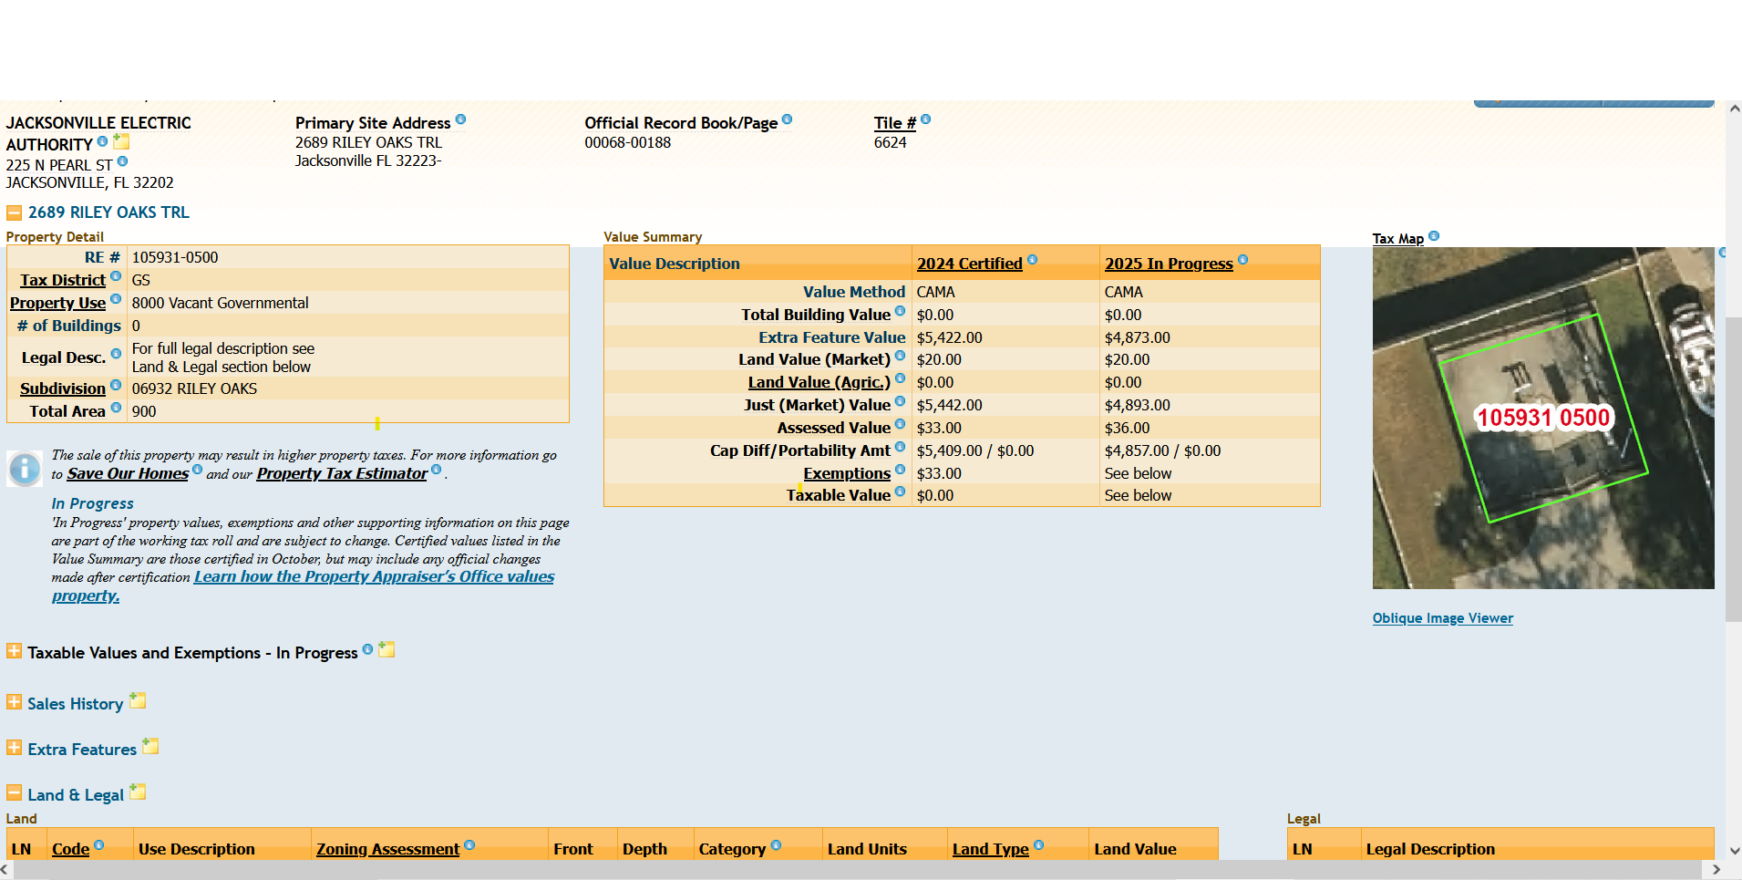
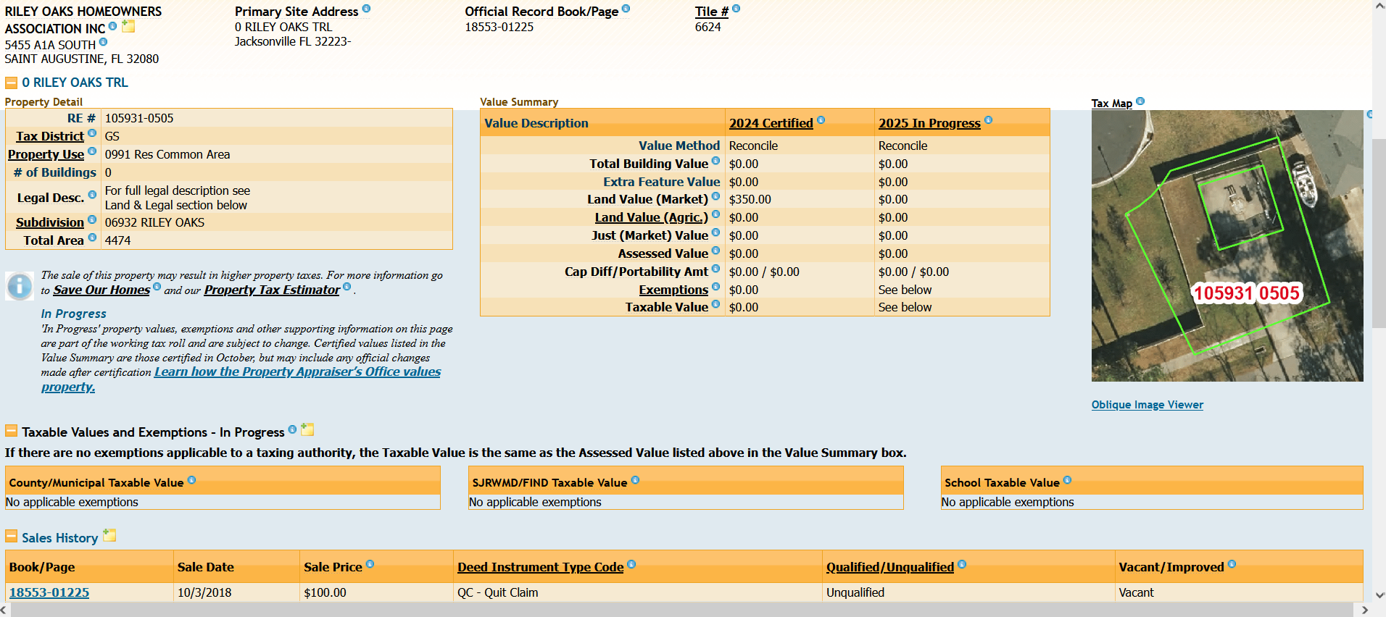
Riley Oaks HOA – COJ Property Appraiser Records
JEA LIFT STATION
Identified as Tract A on the Platt Plan and is irrevocably dedicated to JEA.
LANDSCAPE BUFFER, ACCESS & UTILITIES
Identified as Tract B on the Platt Plan and is to be maintained by property owner {Riley OAKS HOA) in accordance with 656.1223 COJ Ordinance Code.

Slide 4
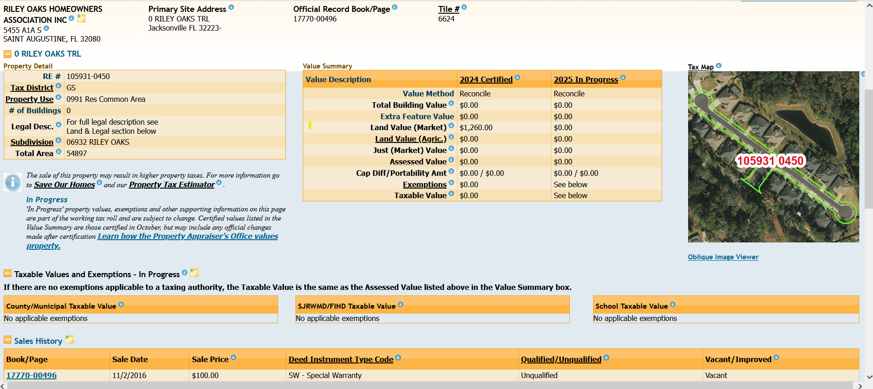
Riley Oaks HOA – COJ Property Appraiser Records

Slide 5
Clarifications
Listed as Common Property for Riley Oaks in the Covenants and in the the COJ property Appraiser Records are:
  Buffer Area (Tract B) around the JEA Lift Station
  Front Entrance area and Roads within Riley Oaks
Not Listed as Common Property for Riley Oaks in the Covenants or in the COJ Property Appraiser Records are:
  Area between the sidewalk and homes on Brady Rd.
  The Vinyl fence along Brady Rd. and Flynn Rd. West.

